Slide 1
Investigating the War over Diversity and Ethics in the AI Community
Jim Ecker

Slide 2
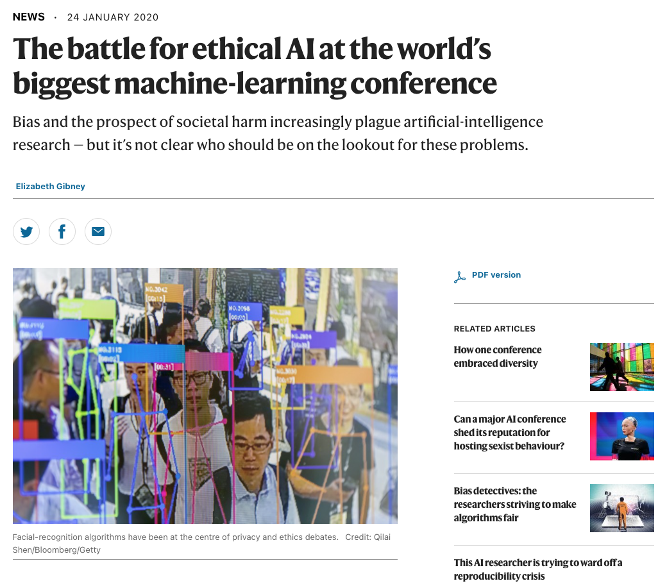
Ideological Lines Being Drawn
Bias in data vs. systems
How to deal with sociological considerations
Diversity and inclusion to introduce more awareness
Does focusing on diversity do harm?
What are the consequences of what you’ve created?
https://www.nature.com/articles/d41586-020-00160-y

Slide 3
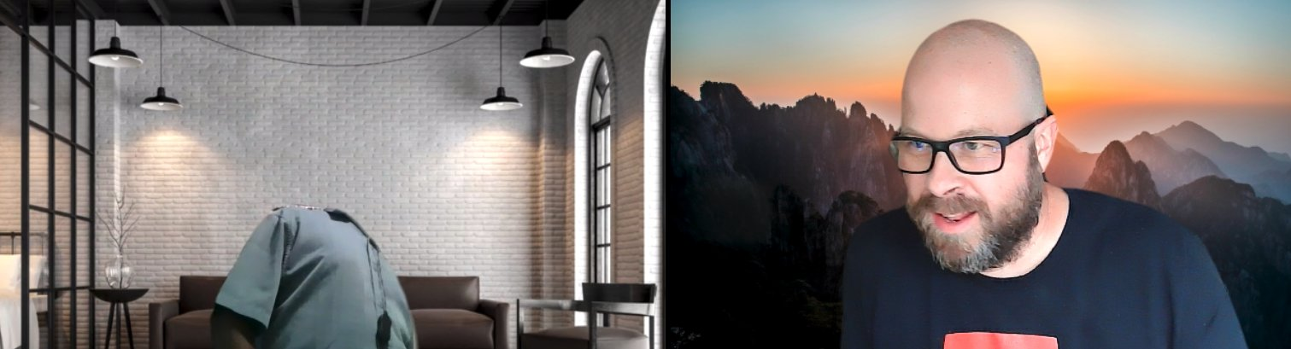
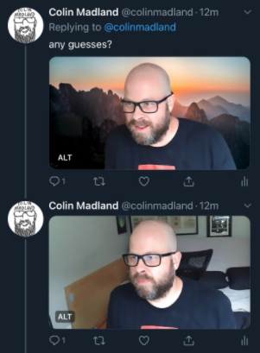
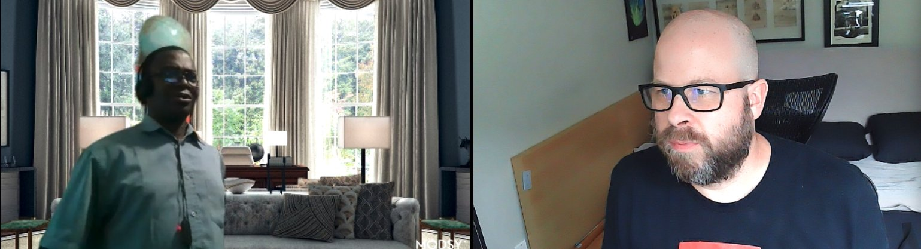
How Do Machine Learning Algorithms Express Their Bias
https://twitter.com/colinmadland/status/1307130447671984129

Slide 4
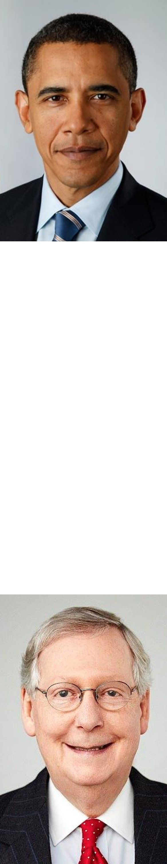
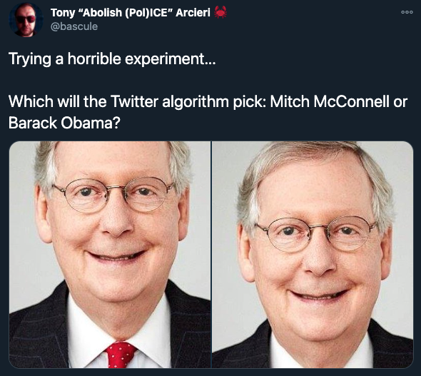
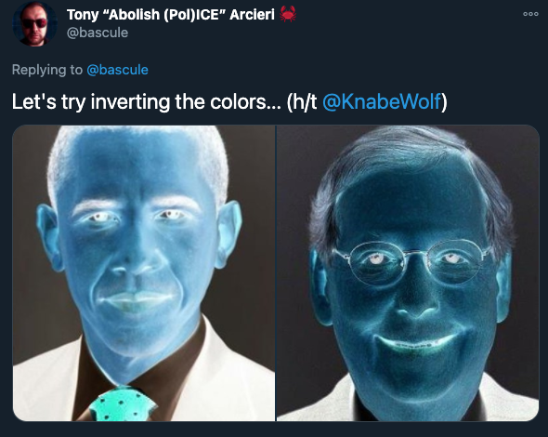
How Does This Bias Affect The Information We Consume?
https://twitter.com/bascule/status/1307440596668182528
https://twitter.com/bascule/status/1307454928806318080?s=20

Slide 5
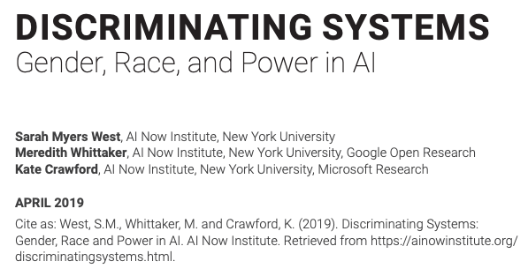
Lack of Diversity in the Field
18% of authors at leading AI conferences are women
80% of AI professors are men
Only 15% of AI research at Facebook and 10% at Google are women
No data on trans or other gender workers
Only 2.5% of Google’s workforce is black
4% at Facebook and Microsoft
https://jfgagne.ai/talent-2019/
http://cdn.aiindex.org/2018/AI%20Index%202018%20Annual%20Report.pdf
https://www.wired.com/story/artificial-intelligence-researchers-gender-imbalance/
https://ainowinstitute.org/discriminatingsystems.pdf

Slide 6
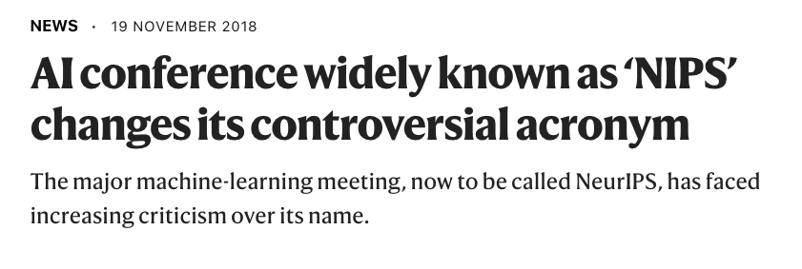
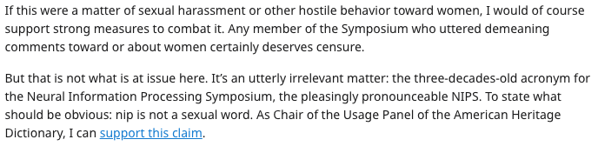
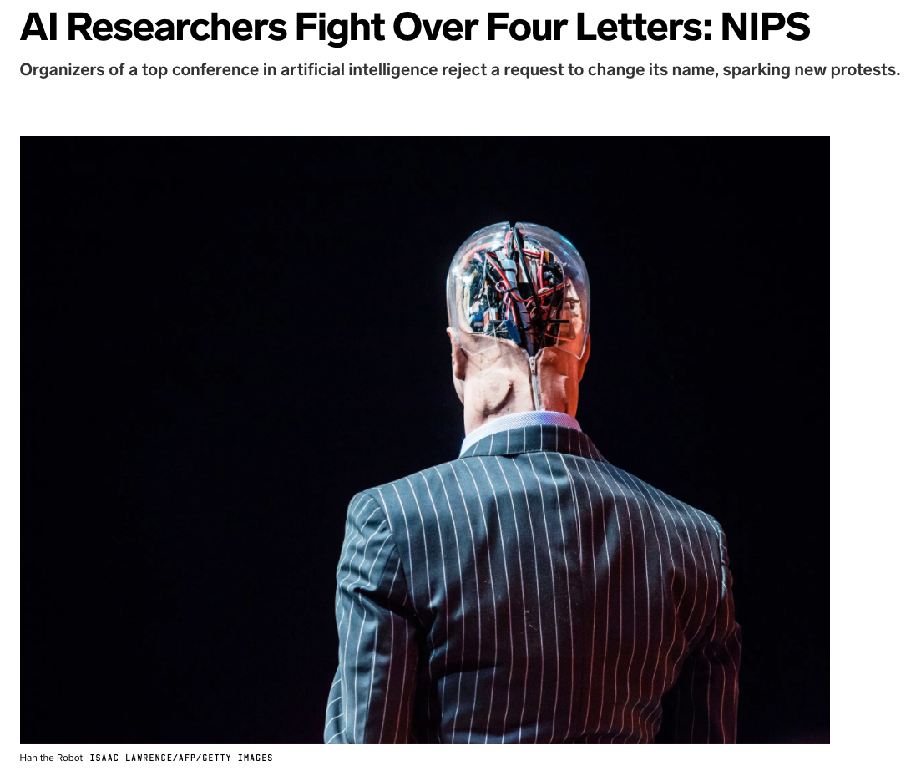
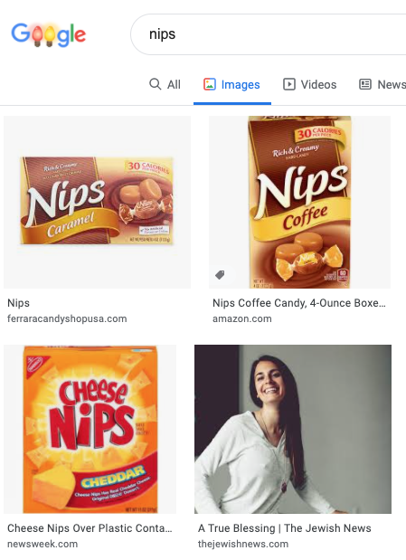
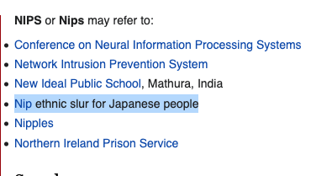
NIPS is Changed to NeurIPS
https://www.scottaaronson.com/blog/?p=4476
https://www.nature.com/articles/d41586-018-07476-w#:~:text=The%20annual%20meeting%20%E2%80%94%20the%20full,next%20meeting%20in%20early%20December.
https://en.wikipedia.org/wiki/NIPS
https://www.wired.com/story/ai-researchers-fight-over-four-letters-nips/

Slide 7
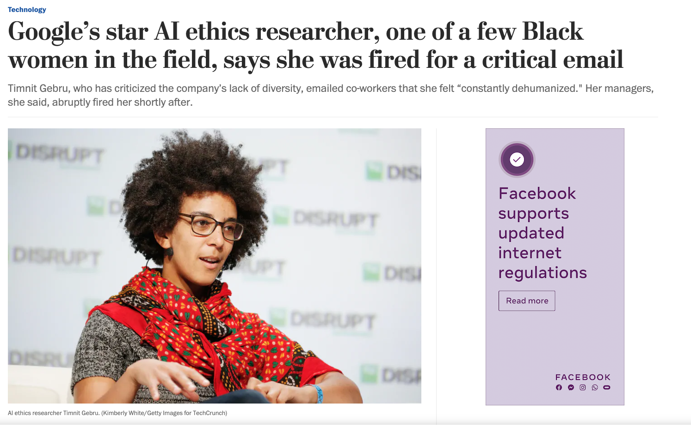
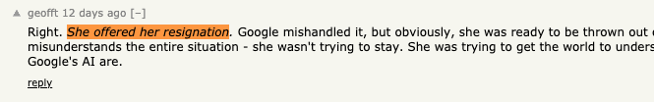
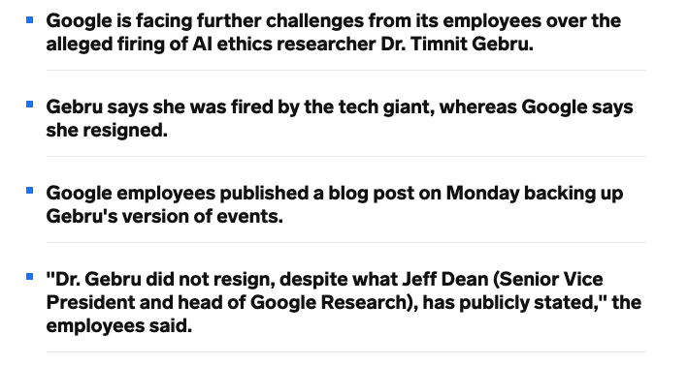
Timnit Gebru is “Resigned” from Google
https://news.ycombinator.com/item?id=25292386
https://www.washingtonpost.com/technology/2020/12/03/timnit-gebru-google-fired/
https://www.businessinsider.com/timnit-gebru-google-firing-ai-researcher-employee-rebellion-jeff-dean-2020-12

Slide 8
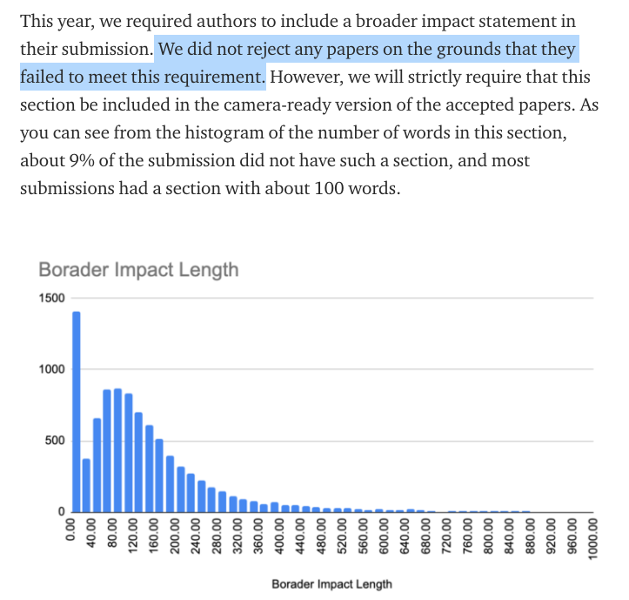
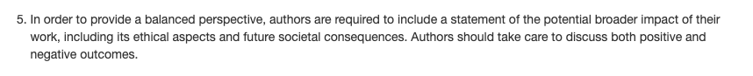
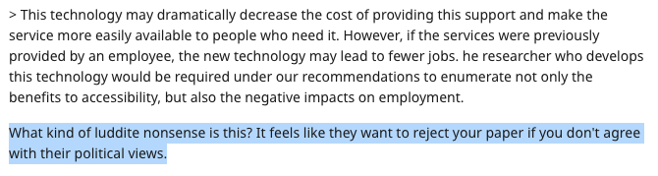
NeurIPS Institutes a New Ethics Review Rule
https://nips.cc/Conferences/2020/CallForPapers
https://www.reddit.com/r/MachineLearning/comments/f6j4dd/d_significant_changes_for_the_neurips_2020_review/
https://neuripsconf.medium.com/what-we-learned-from-neurips-2020-reviewing-process-e24549eea38f

Slide 9

Dr. Anima Anandkumar
Bren professor at the California Institute of Technology’s CMS department
A director of machine learning research at NVIDIA
Lead the development of Tensor algorithms
Campaigned for the NeurIPS name change
Strong advocate for diversity and inclusivity measures in the industy
https://iqim.caltech.edu/profile/anima-anandkumar/

Slide 10
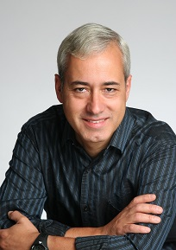
Dr. Pedro Domingos
Professor Emeritus of Computer Science at the University of Washington
Author of “The Master Algorithm”
Known for Markov Logic Networks
Actively denies the existence of algorithmic biases
Argues that diversity efforts discriminate against men
”Anti-woke”
https://cdn.geekwire.com/wp-content/uploads/2020/09/pedro.jpg

Slide 11
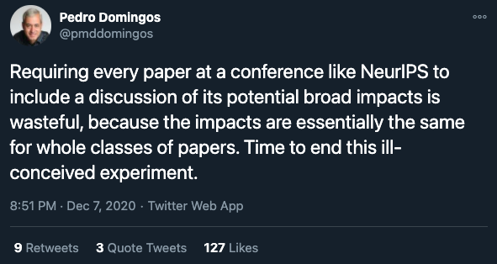
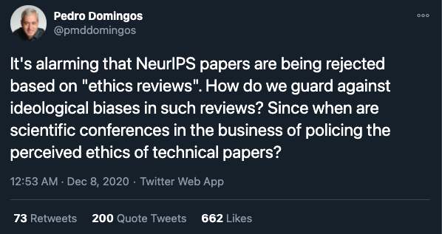
Pedro Speaks Out Against the NeurIPS Ethics Reviews
https://web.archive.org/web/20201208015148/https://twitter.com/pmddomingos/status/1336126175790284800
https://web.archive.org/web/20201208055420/https://twitter.com/pmddomingos/status/1336187141366317056

Slide 12
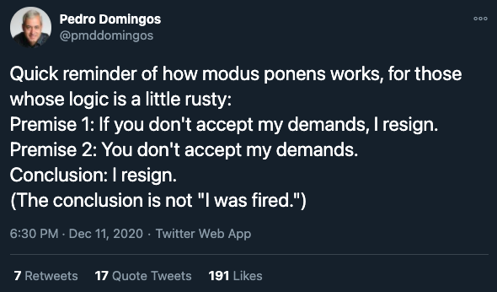
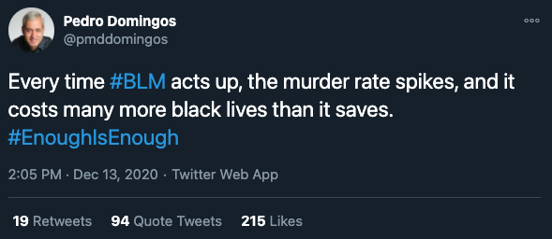
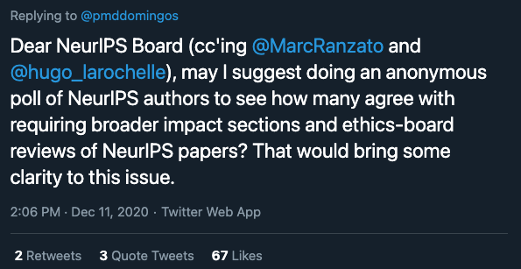
And Other Things
https://web.archive.org/web/20201213190757/https://twitter.com/pmddomingos/status/1338198481672962050
https://web.archive.org/web/20201211233023/https://twitter.com/pmddomingos/status/1337540166299226112

Slide 13
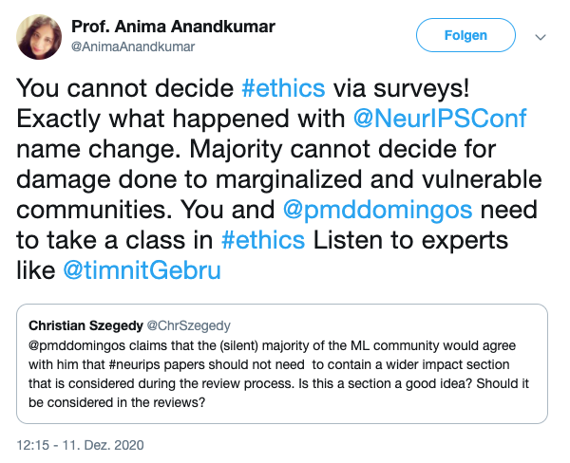
And He Finally Gets Anima’s Attention
https://web.archive.org/web/20201211190725/https://twitter.com/pmddomingos/status/1337473782865260545
https://web.archive.org/web/20201211201614/https://twitter.com/AnimaAnandkumar/status/1337491318776328192

Slide 14
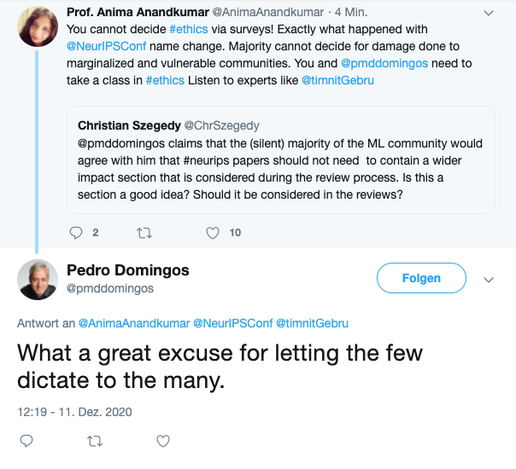
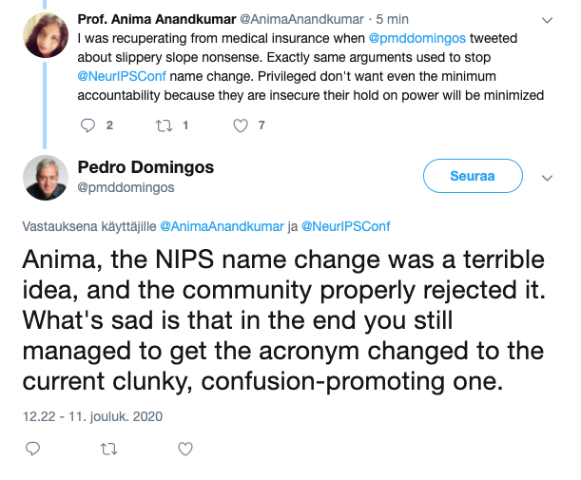
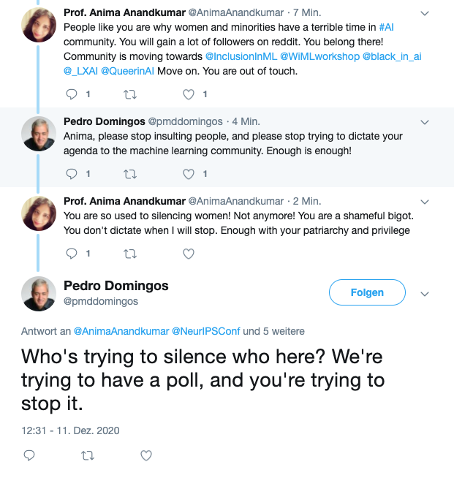
And It Escalates
https://web.archive.org/web/20201211202011/https://twitter.com/pmddomingos/status/1337492277904564226
https://web.archive.org/web/20201211202348/https://twitter.com/pmddomingos/status/1337492920350359552
https://web.archive.org/web/20201211203213/https://twitter.com/pmddomingos/status/1337495228211552258

Slide 15
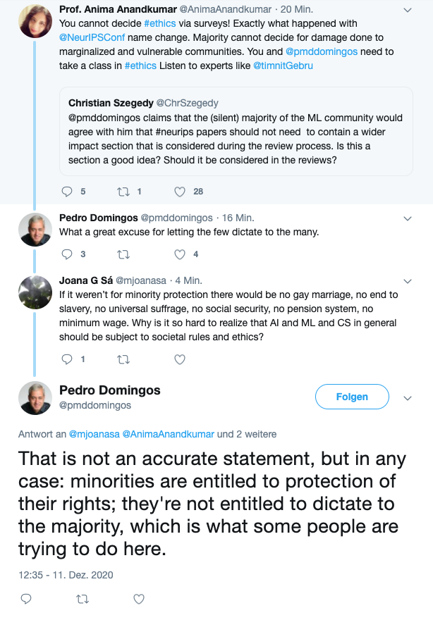
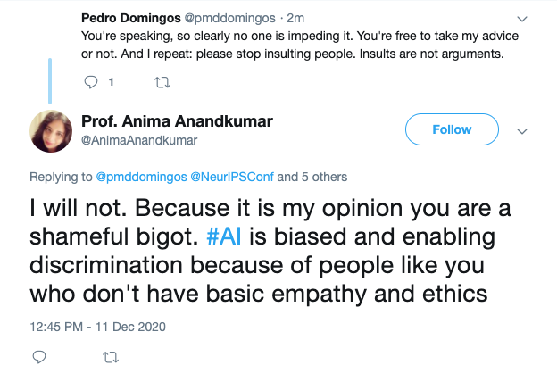
Until They Make Statements That Rile Up Each Other’s Supporters
https://web.archive.org/web/20201211204613if_/https:/twitter.com/AnimaAnandkumar/status/1337498861695188992
https://web.archive.org/web/20201211203619/https:/twitter.com/pmddomingos/status/1337496365304143872

Slide 16
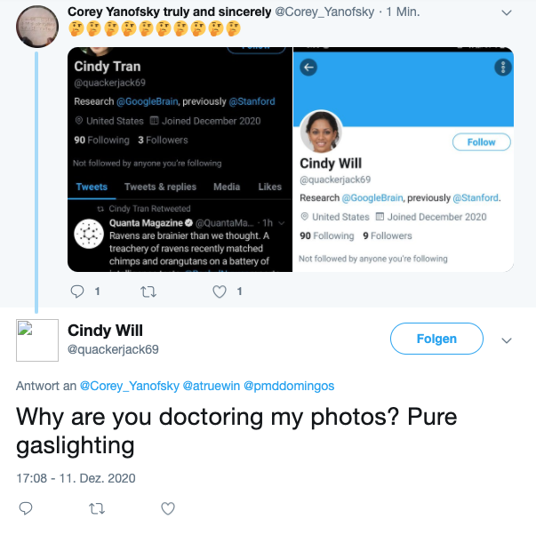
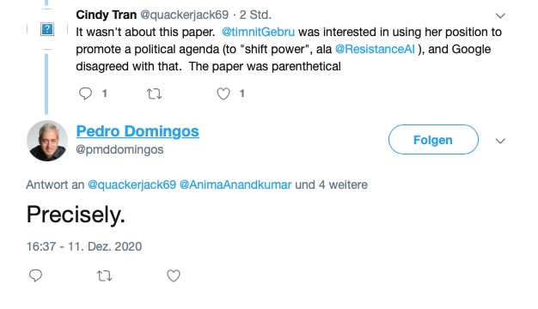
Eventually Some Sockpuppets Come to Pedro’s Defense
https://web.archive.org/web/20201212003812/https://twitter.com/pmddomingos/status/1337557152664178688
https://web.archive.org/web/20201212010855/https://twitter.com/quackerjack69/status/1337564968389140481

Slide 17
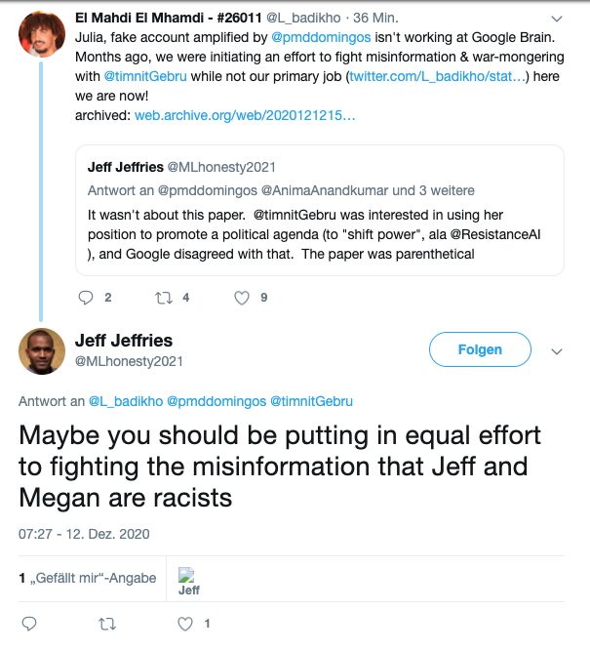
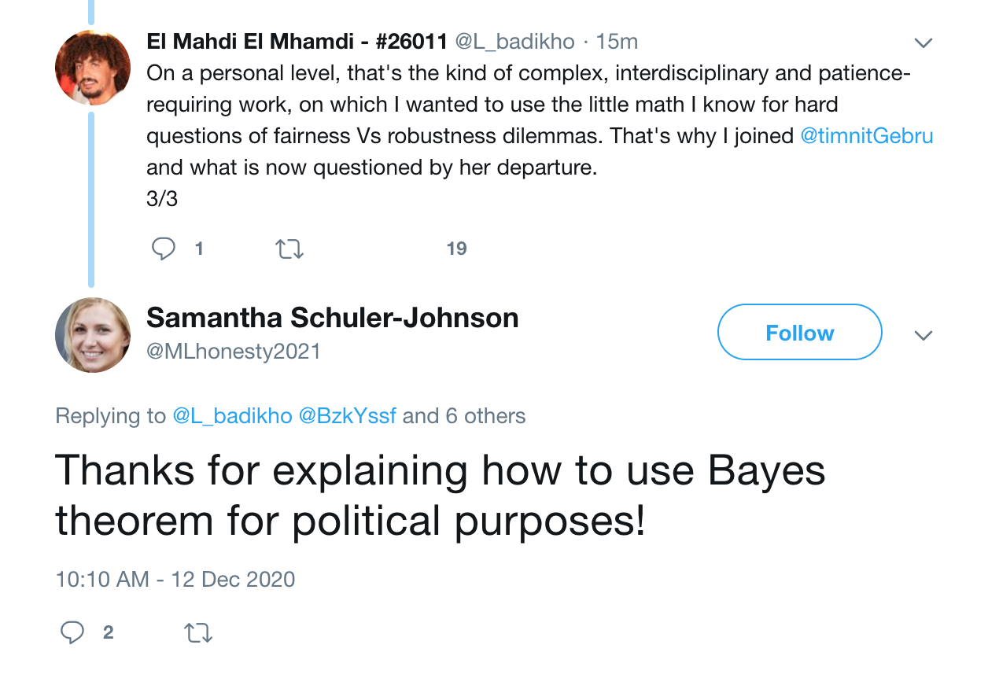
Eventually Some Sockpuppets Come to Pedro’s Defense
https://web.archive.org/web/20201212182237/https://twitter.com/MLhonesty2021/status/1337822195989553154
https://web.archive.org/web/20201212160110/https://twitter.com/MLhonesty2021/status/1337781161846853633

Slide 18
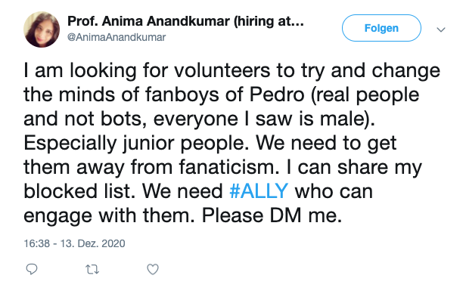
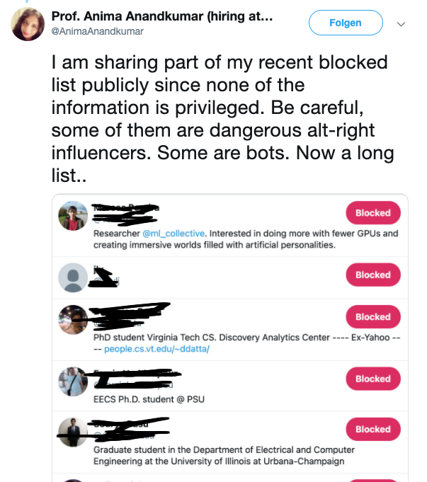
And Anima Puts Out Her Block List
http://web.archive.org/web/20201214003901/https://twitter.com/AnimaAnandkumar/status/1338282250614411264
https://web.archive.org/web/20201214005701/https://twitter.com/AnimaAnandkumar/status/1338286786666090498

Slide 19
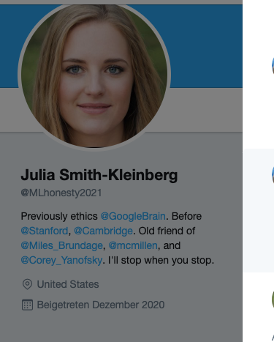
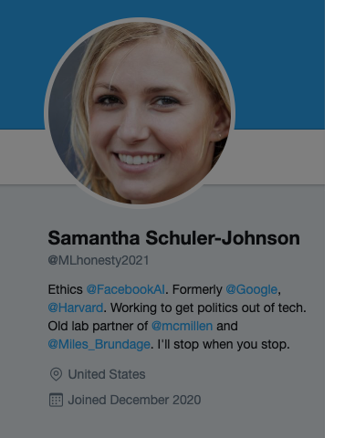
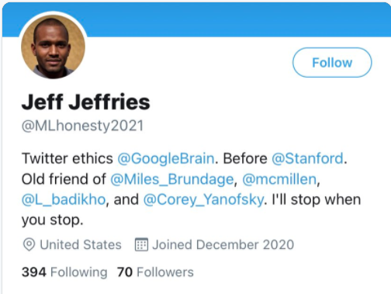

The Sockpuppets – MLHonesty2021
curl -s "http://web.archive.org/cdx/search/cdx?url=https://twitter.com/mlhonesty2021&matchType=prefix" | sort -u -k 3 | sort -k 2 | awk '{print "https://web.archive.org/web/" $2 "/" $3 " " $5};'
https://web.archive.org/web/20201212153151/https://twitter.com/MLhonesty2021/status/1337776943849230338
https://web.archive.org/web/20201212182237/https://twitter.com/MLhonesty2021/status/1337822195989553154
https://web.archive.org/web/20201212180433/https://twitter.com/MLhonesty2021/status/1337818192723456000
Frequent user pic and name changes
All photos appear to be GAN generated https://thispersondoesnotexist.com/
All claim to be ethicists who worked with Timnit Gebru
Accounts started this month
Low follower accounts
Lack of engagement
https://twitter.com/mlhonesty2021

Slide 20
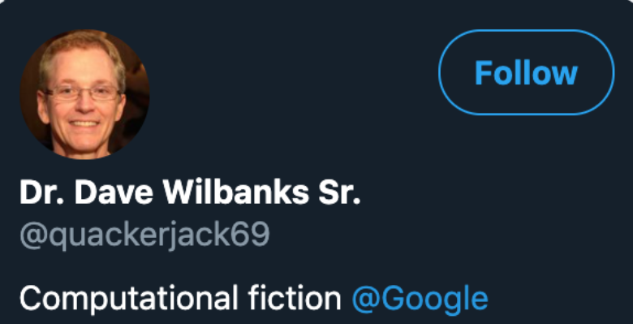
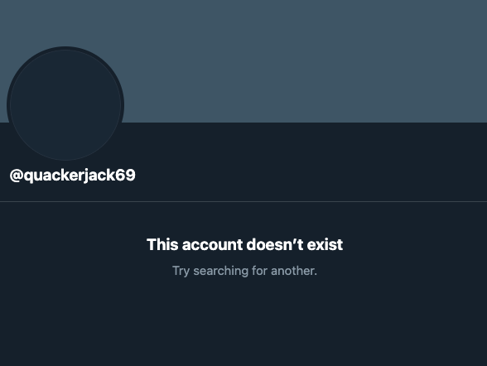
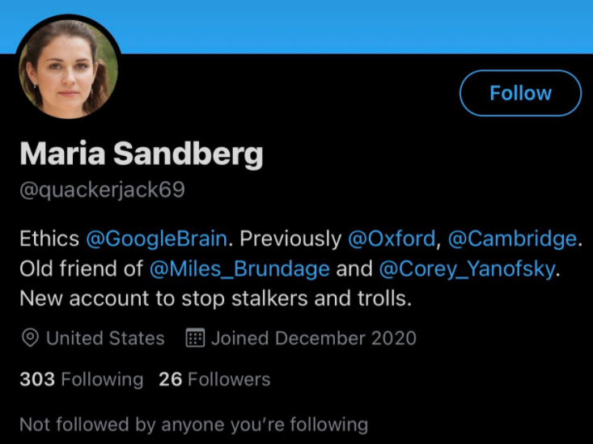
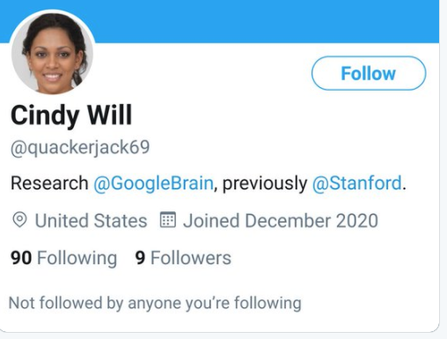
The Sockpuppets – quackerjack69
curl -s "http://web.archive.org/cdx/search/cdx?url=https://twitter.com/quackerjack69&matchType=prefix" | sort -u -k 3 | sort -k 2 | awk '{print "https://web.archive.org/web/" $2 "/" $3 " " $5};'
https://twitter.com/lucy3_li/status/1337574792774369285?s=20
https://twitter.com/mihaela_v/status/1337613673448128514?s=20
https://web.archive.org/web/20201212015842/https://twitter.com/quackerjack69/status/1337577321302265856

Slide 21
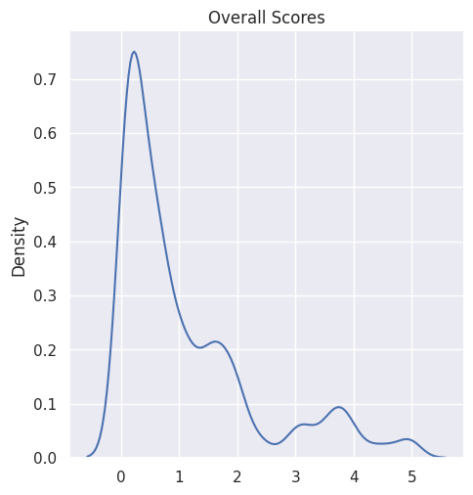
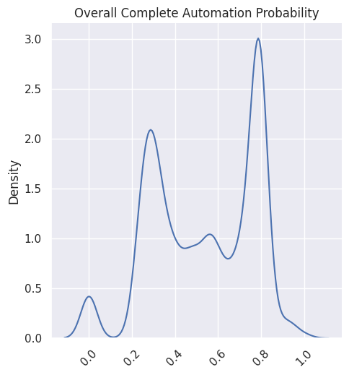
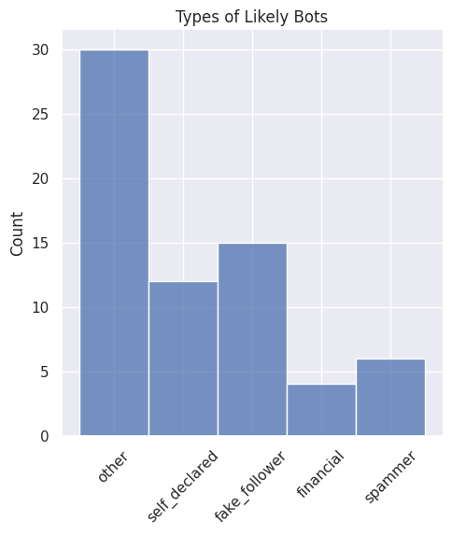
Anima’s Blocked List Analyzed

Slide 22
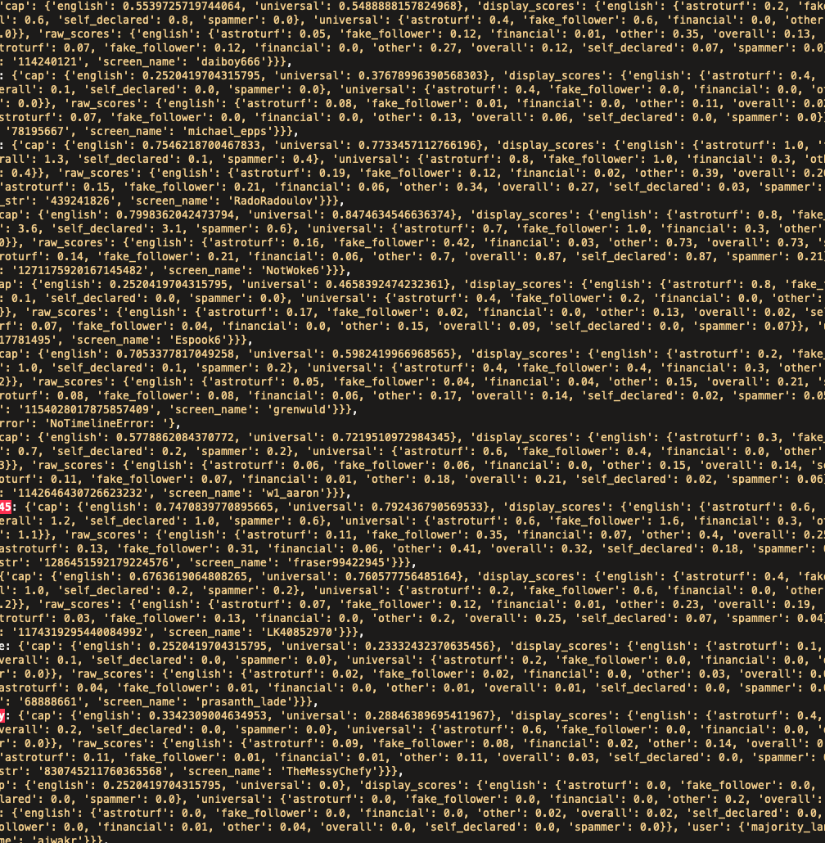
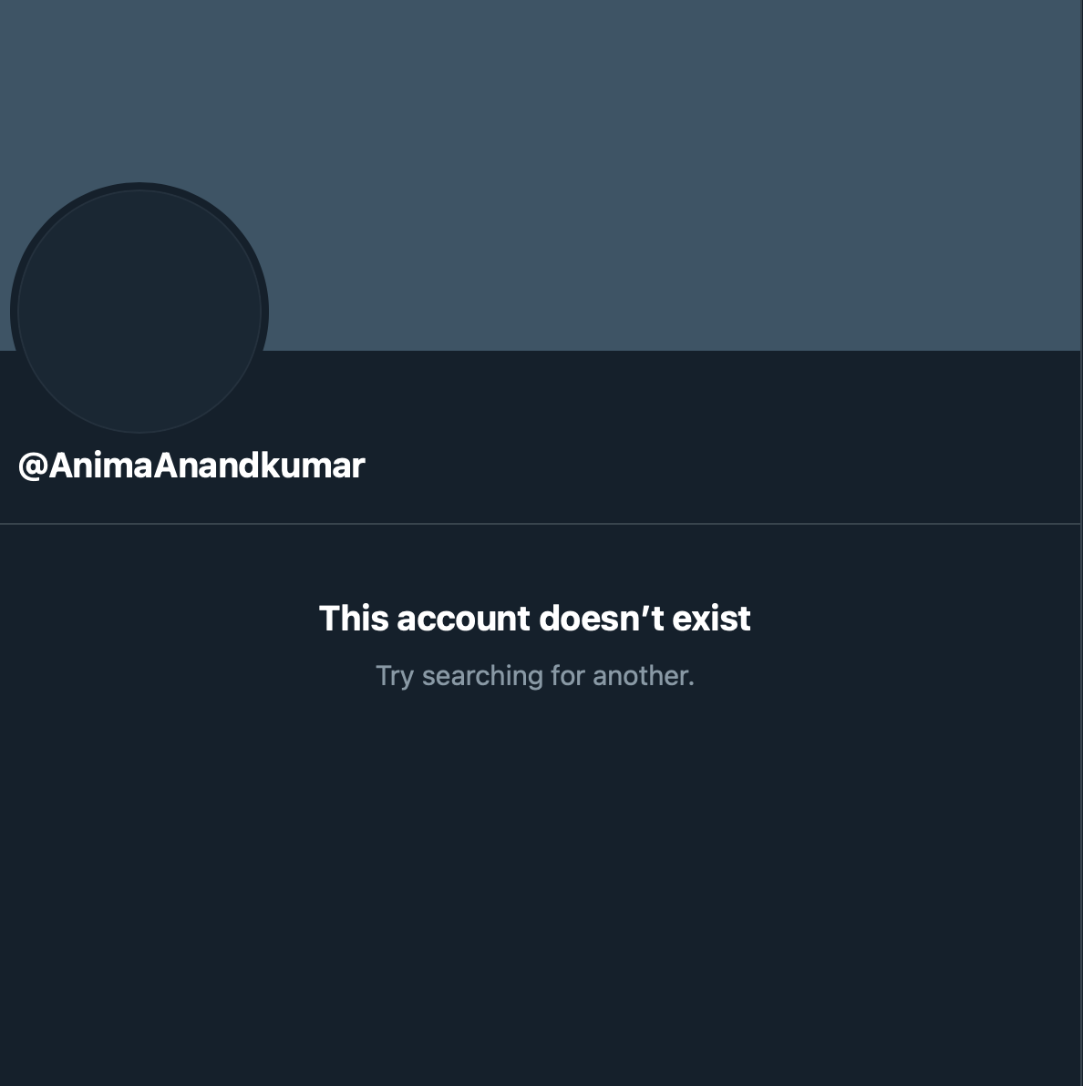
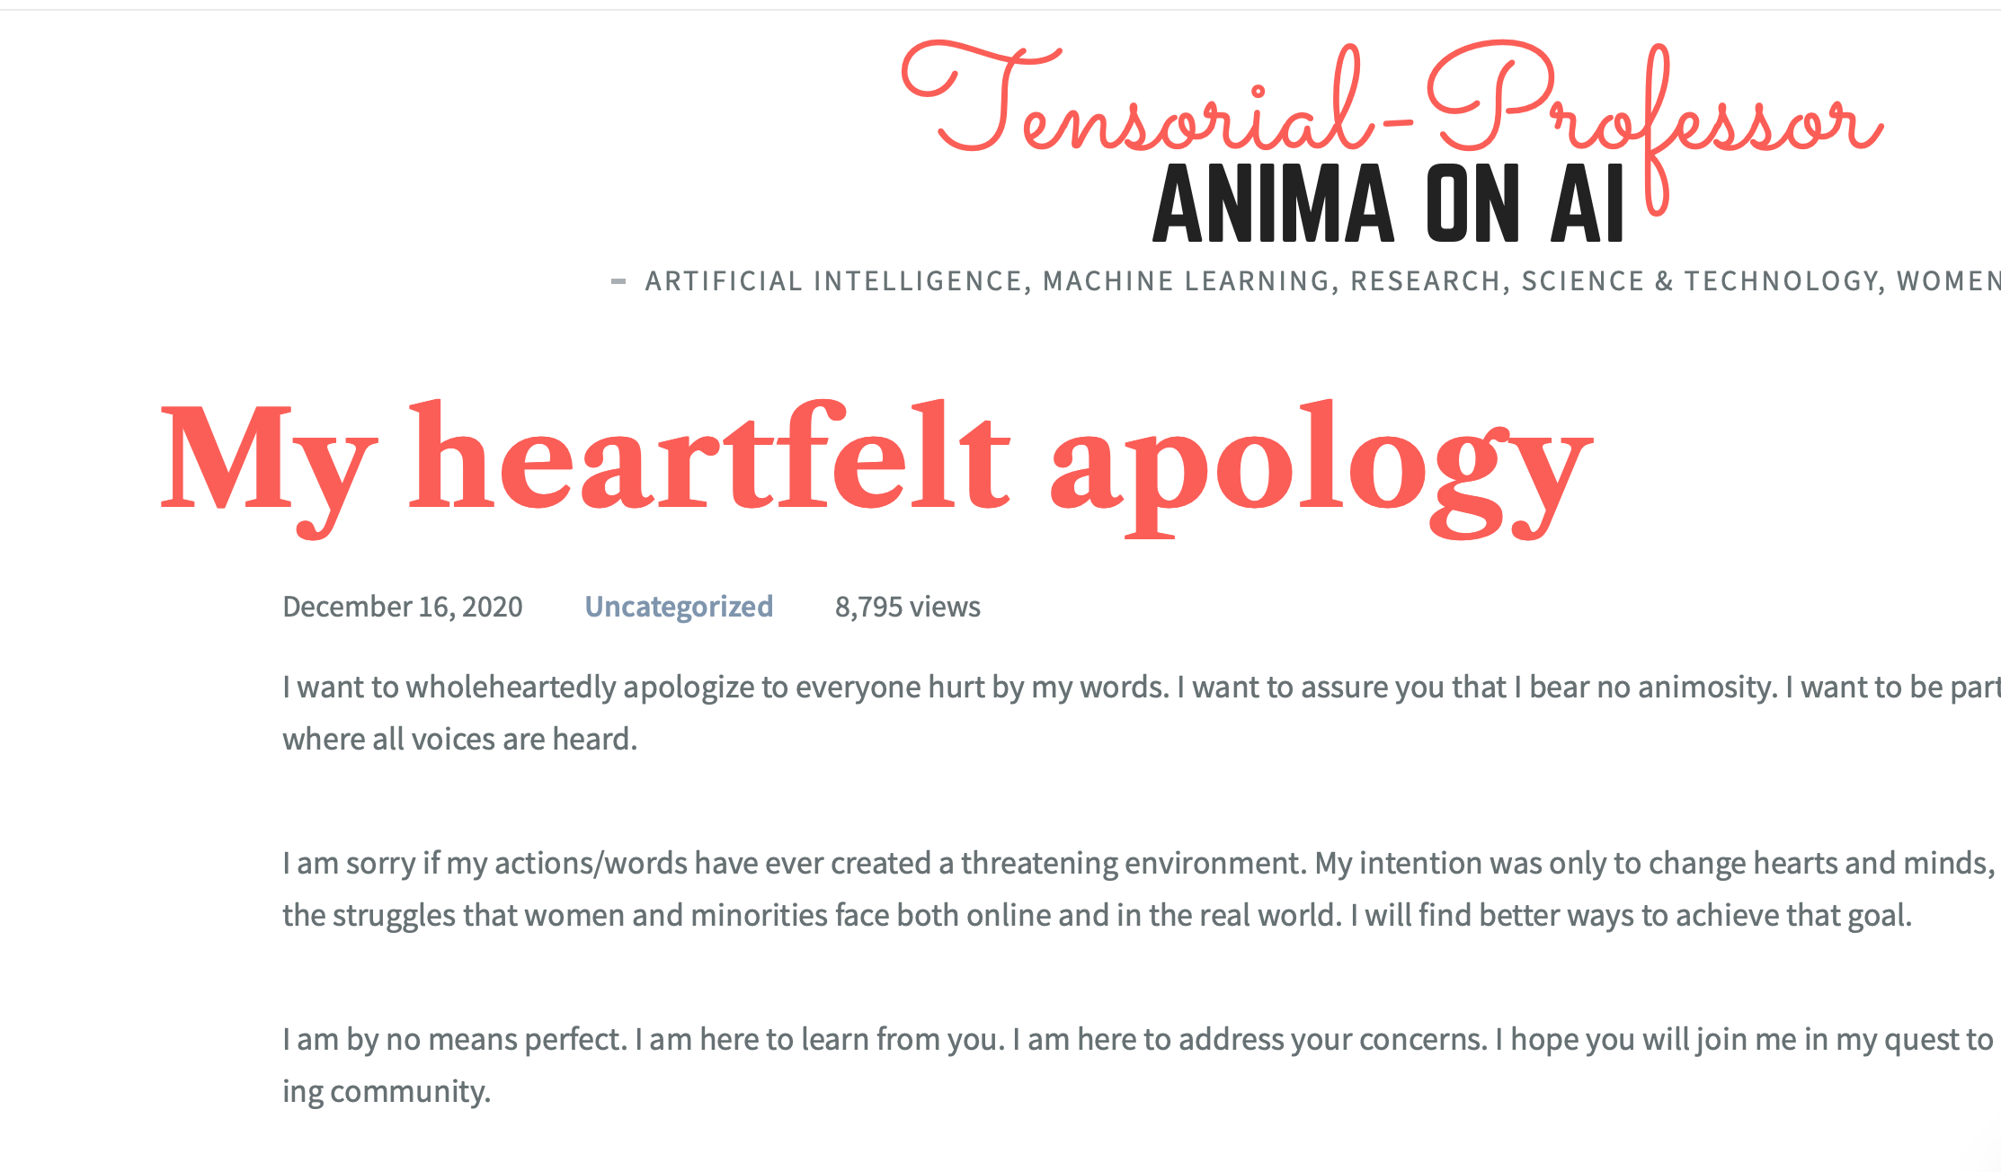
Anima’s Blocked List
curl -s "http://web.archive.org/cdx/search/cdx?url=https://twitter.com/AnimaAnandkumar&matchType=prefix" | sort -u -k 3 | sort -k 2 | awk '{print "https://web.archive.org/web/" $2 "/" $3 " " $5};'
320 Twitter accounts
14 accounts deleted since
Ran through Botometer to get analysis of their usage
20201214005701-20201214011442
https://animakumar.wpcomstaging.com/2020/12/16/my-heartfelt-apology/
https://twitter.com/AnimaAnandkumar

Slide 23
Conclusion
The events in this presentation all happened within the last five days
It represents an investigation of deleted and archived data in real time

